Slide 1
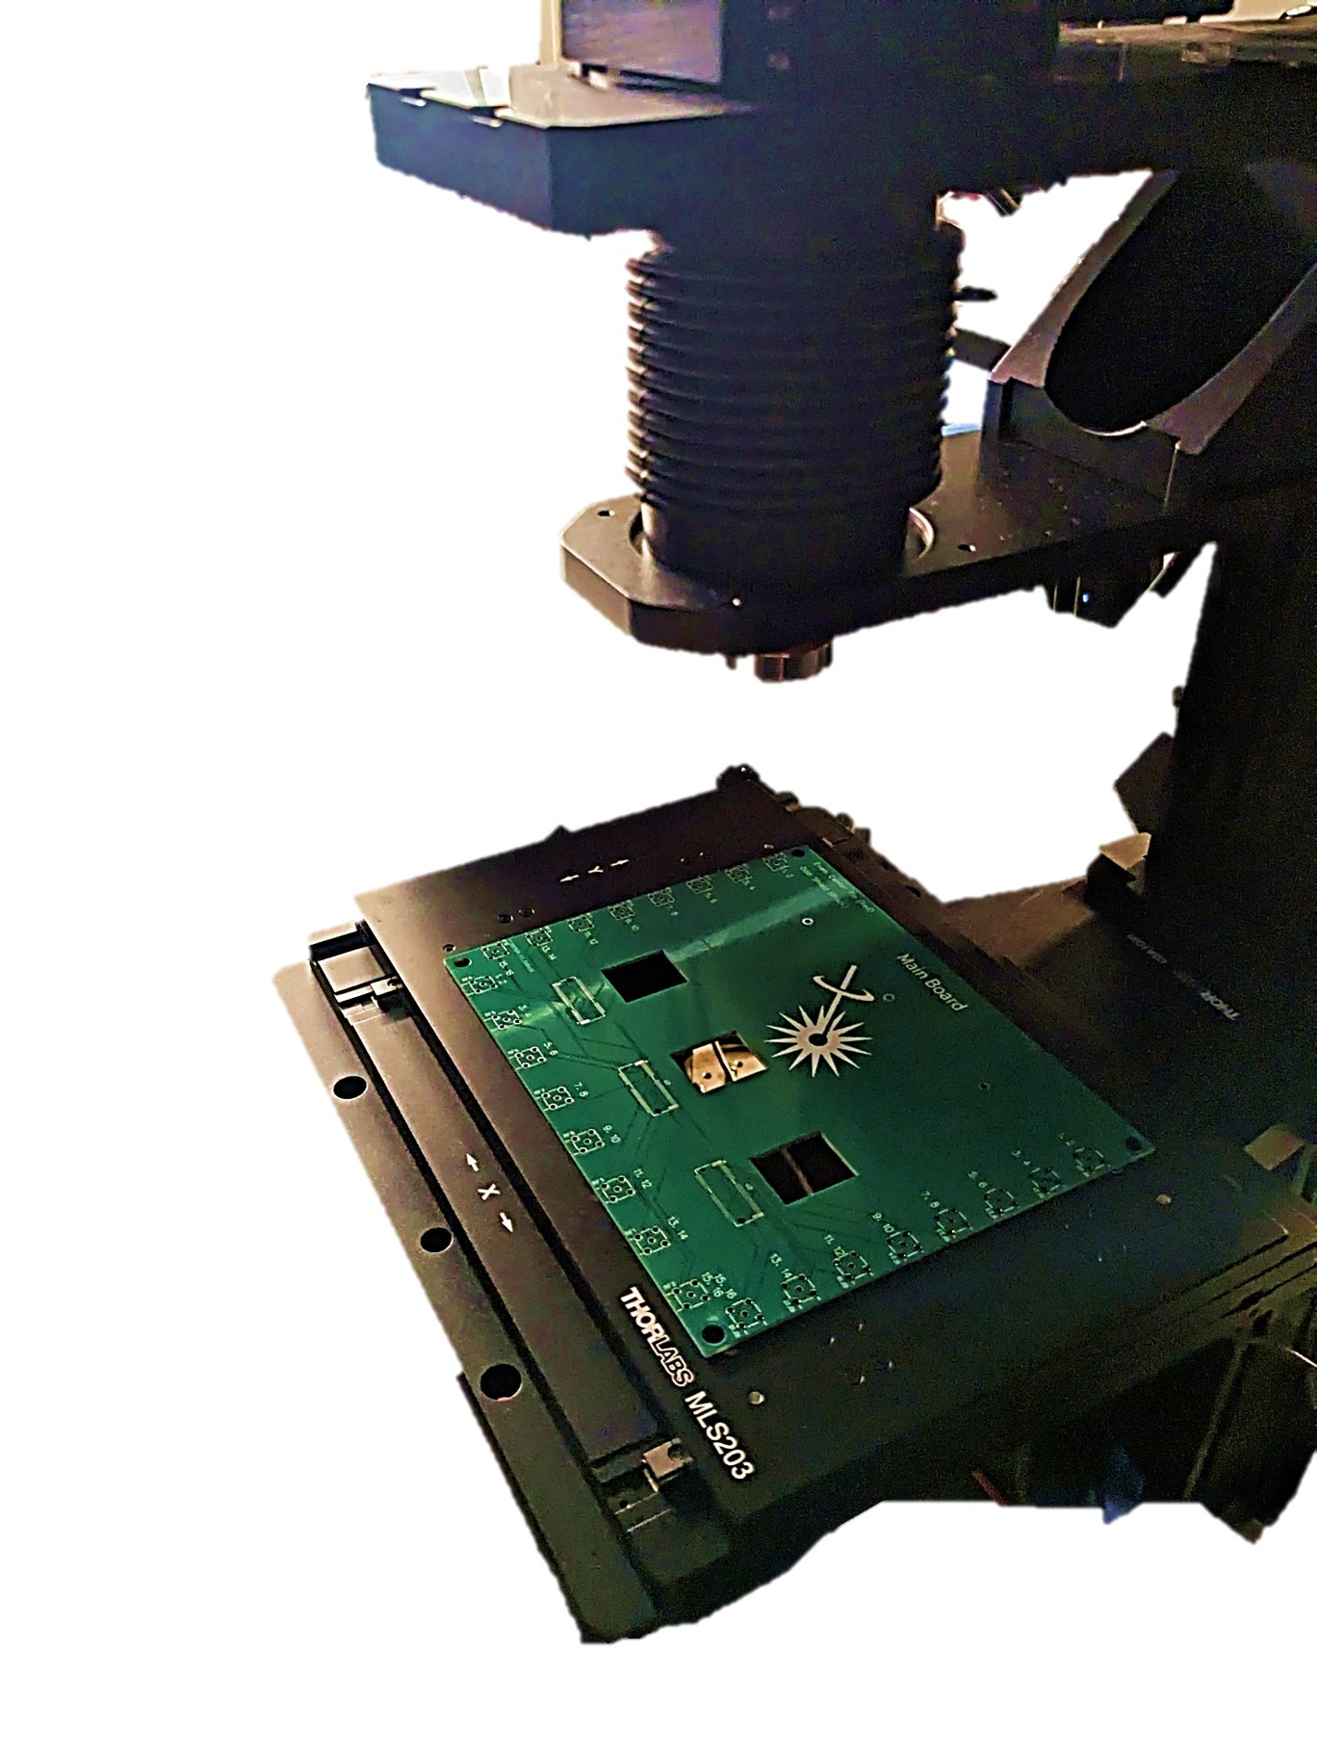
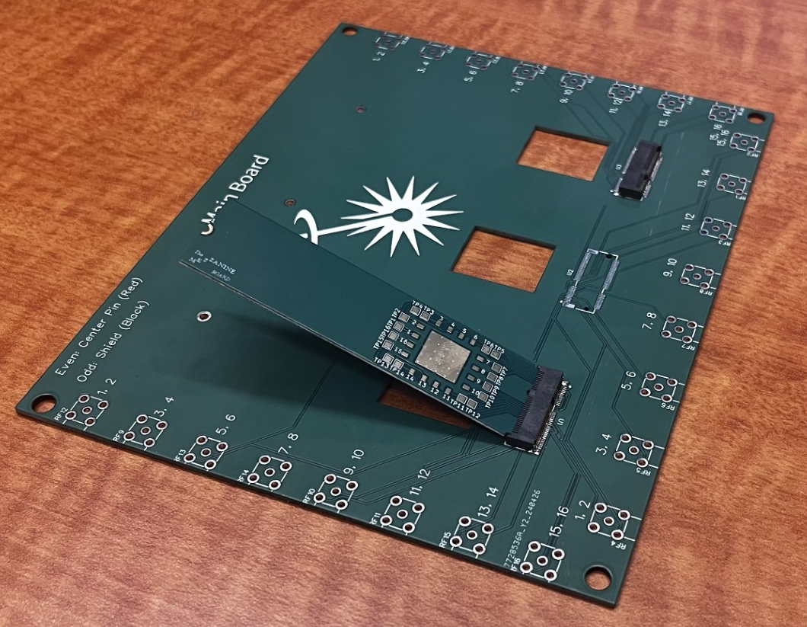
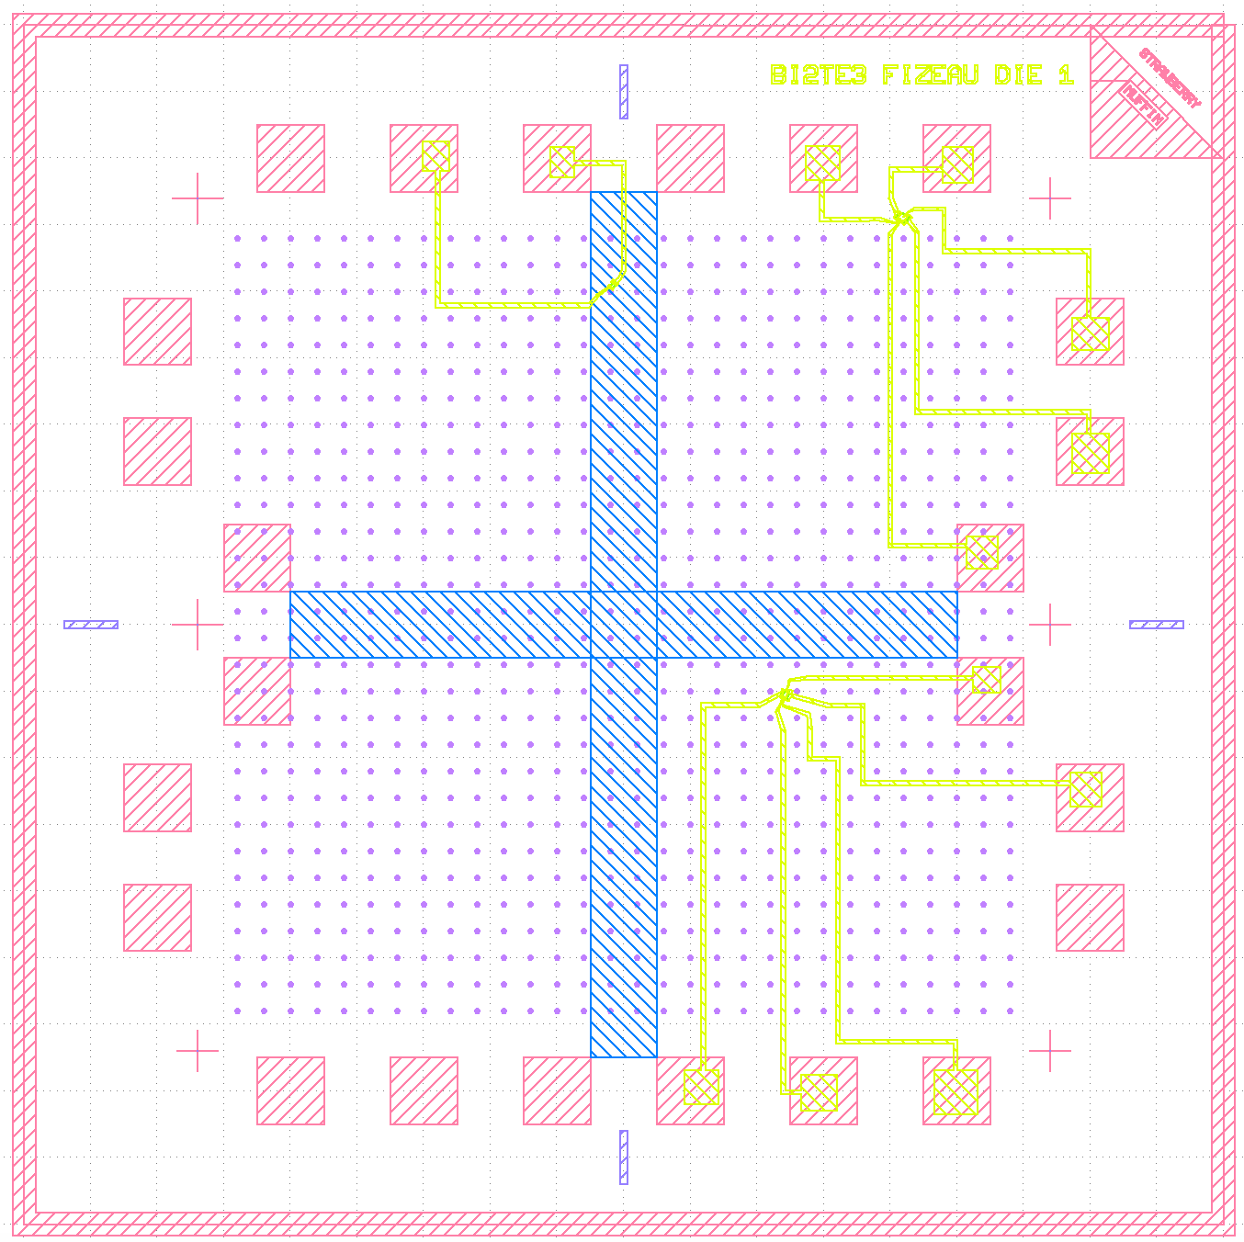
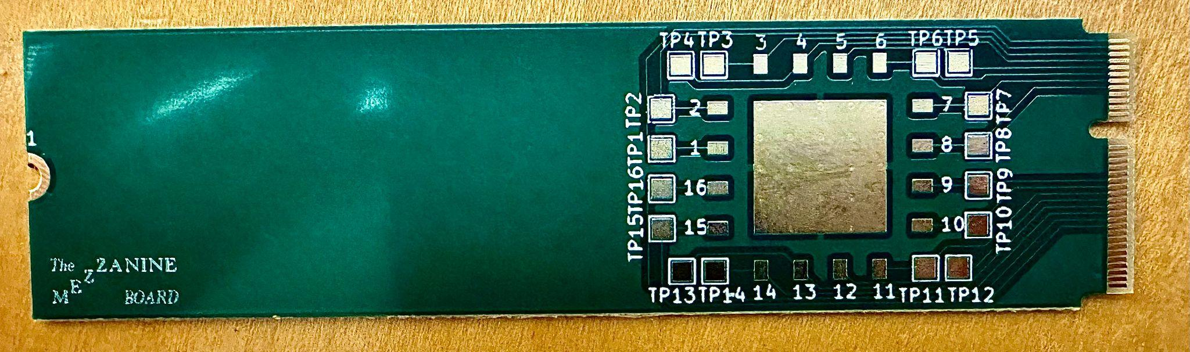
SPCM Sample Stage
&
Silicon Die Design Code
Notes:
Preview pictures
Slide numbers
Speak slower
Pause between motivation, project, between projects, etc. to clarify moving between ideas

Slide 2
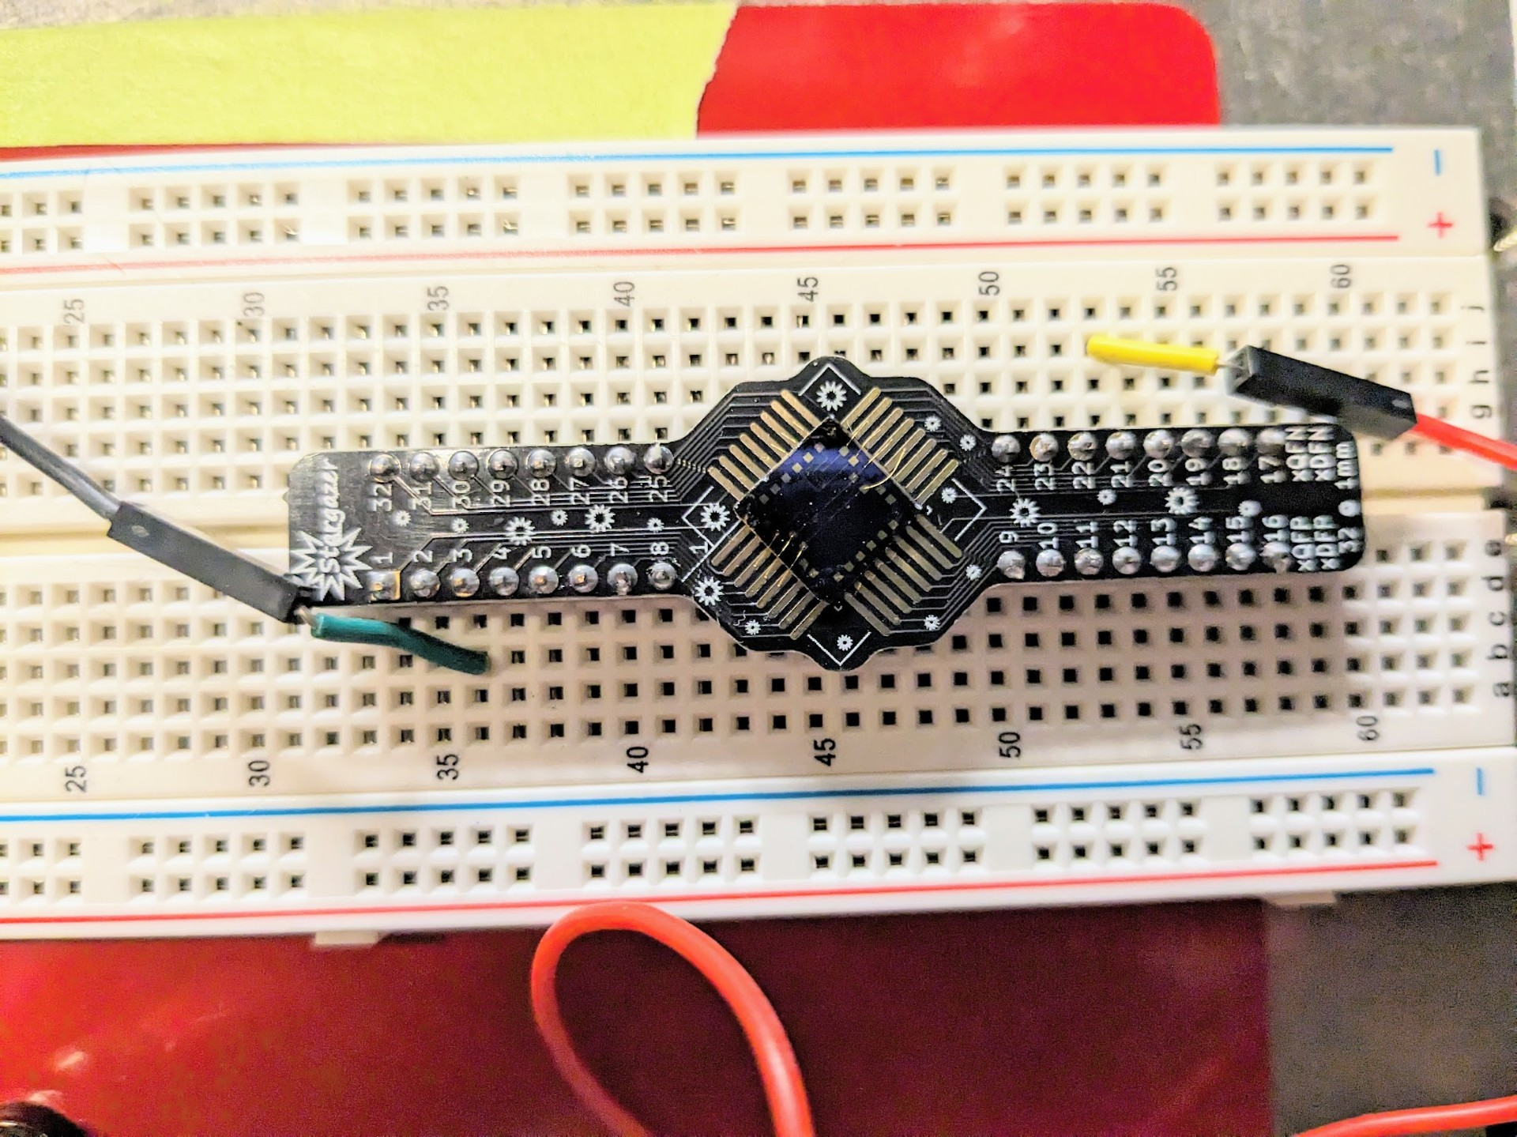
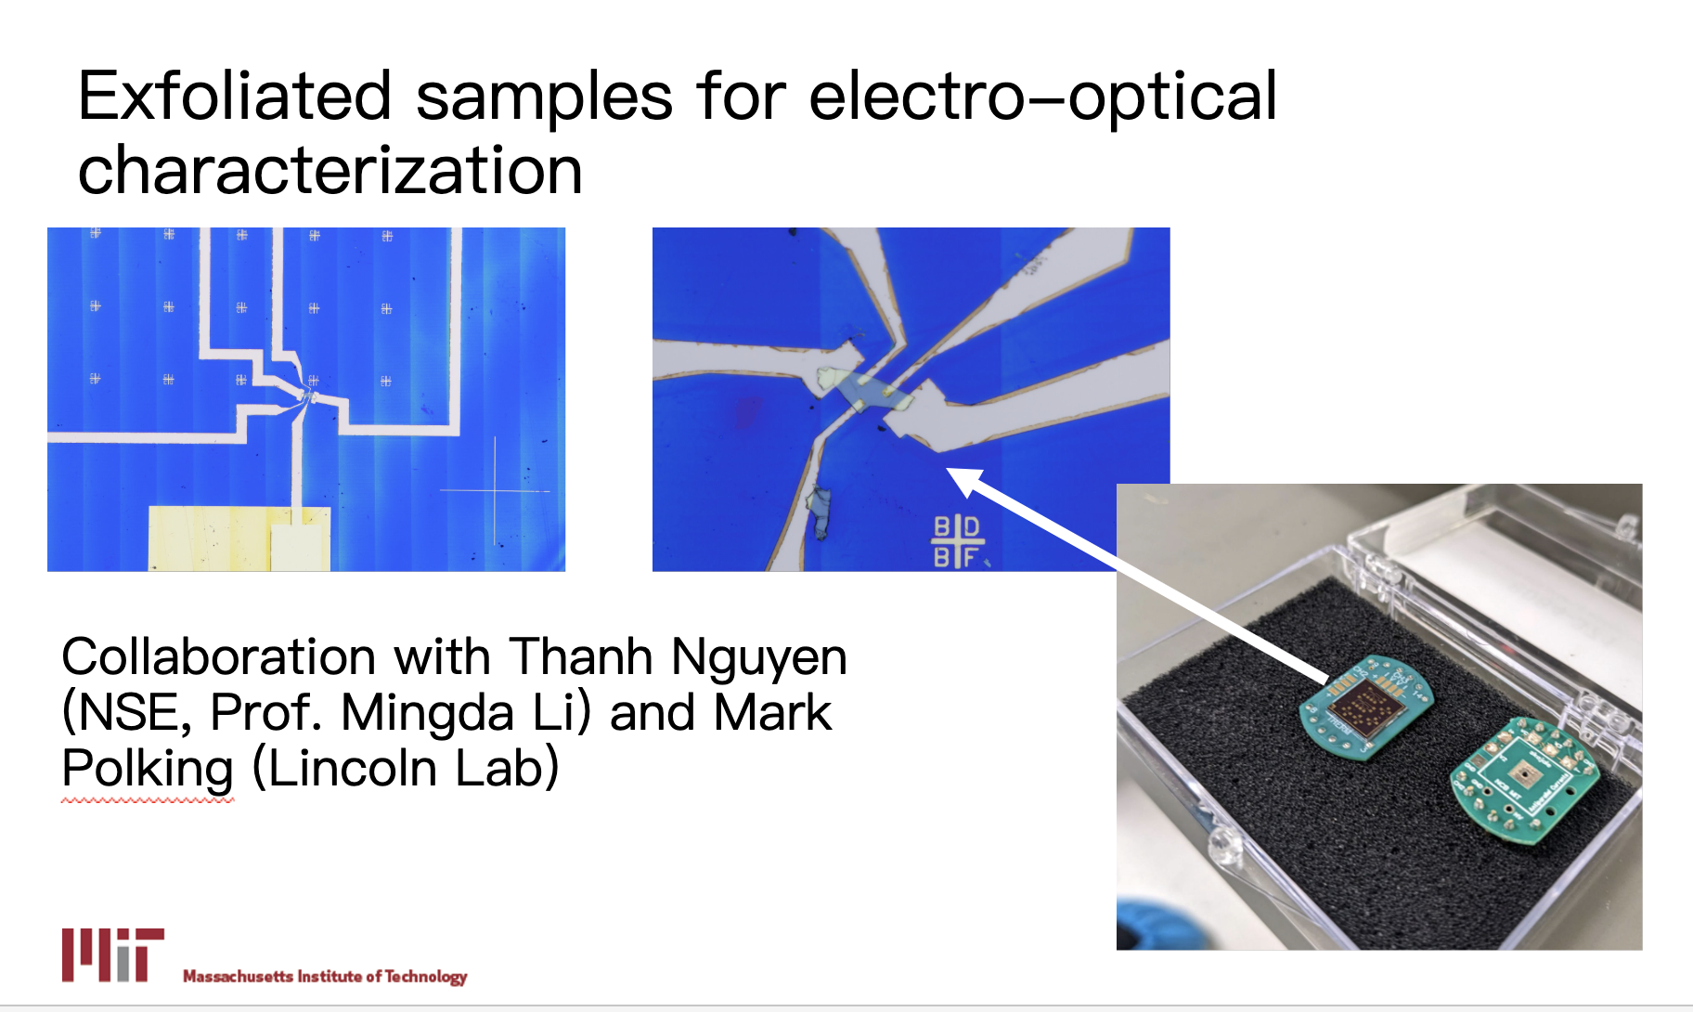
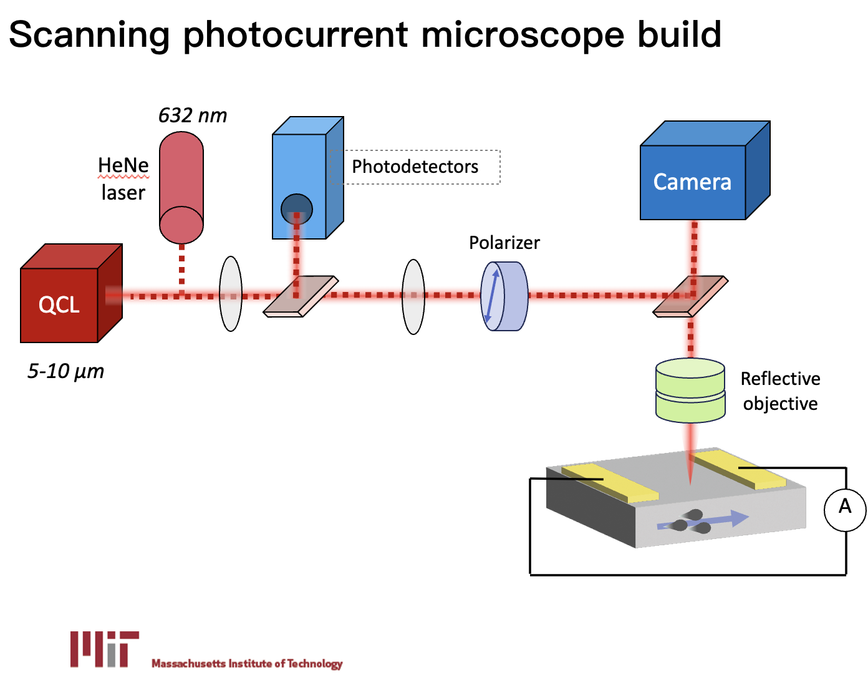
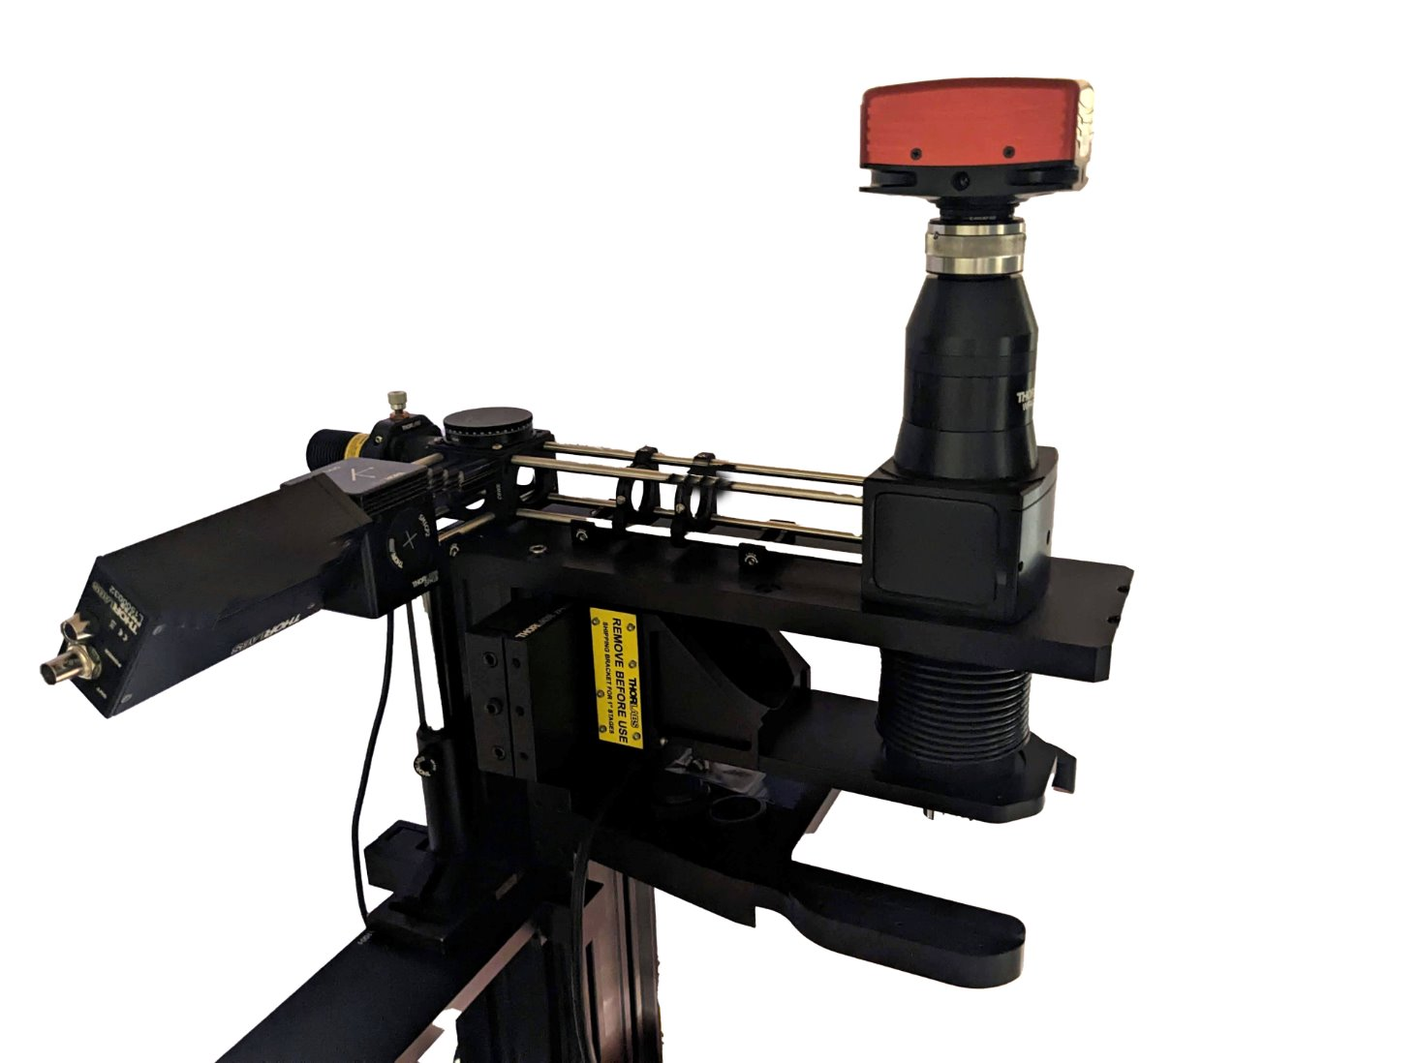
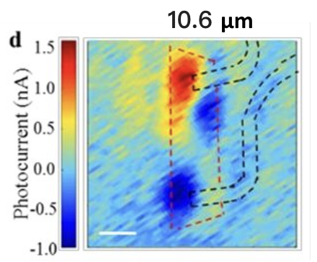
Improving reliability and efficiency of making photocurrent measurement in quantum materials
Sample
Our sample stage
measurement
Notes:
A lot of samples- efficient ways to connect samples to the setup;

Slide 3
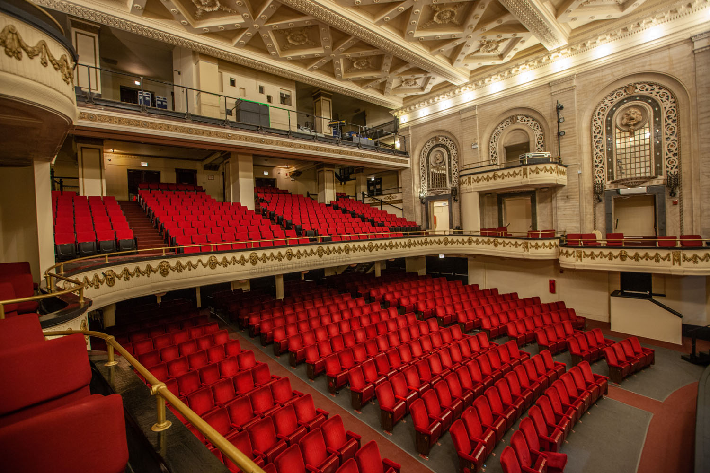
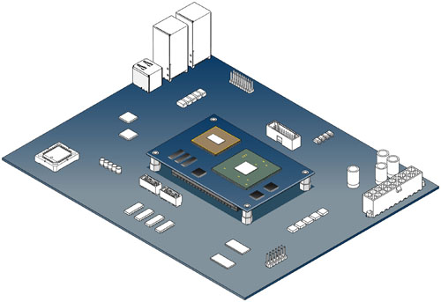
Sample → “Mezzanine boards”
→ main board → measurement device
(Brady’s presentation)
Notes:
Mezzanine boards: reliable connection to sample and main board

Slide 4
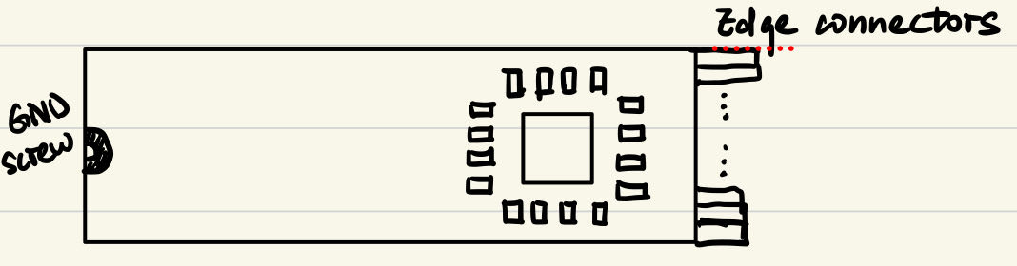
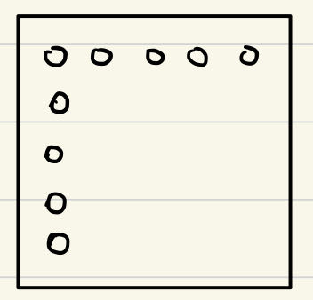
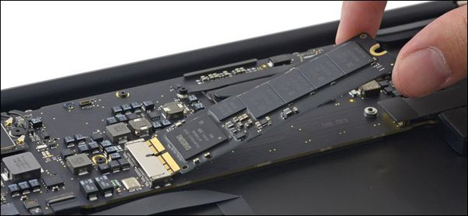
Design sketches
Silicon die goes on the via array
To main board
To sample
To main board
0.5mm filled vias array for thermal relief
Heat sink beneath
Notes:
Mezzanine board should have:
Good thermal relief
Reliable connection to sample: wire bonding capability, and intuitive pad labeling system
Reliable connection to main board: mechanical and electrically secure, easy to assemble

Slide 5
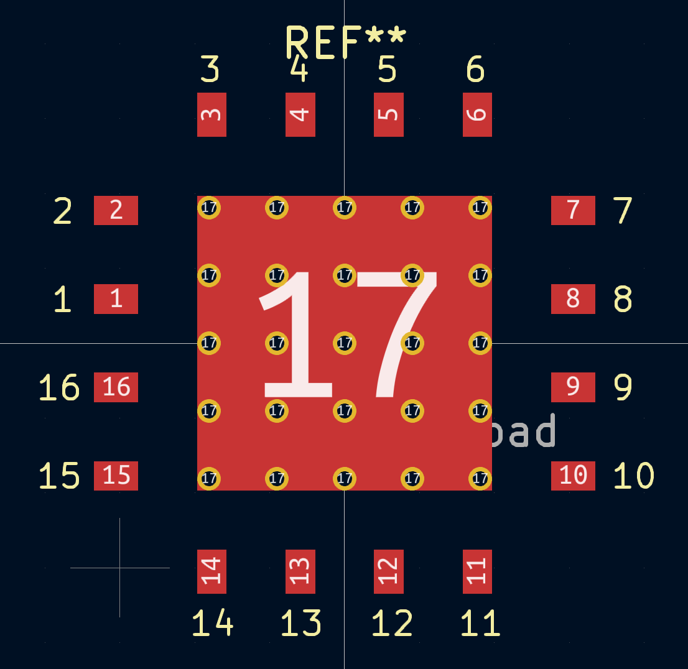
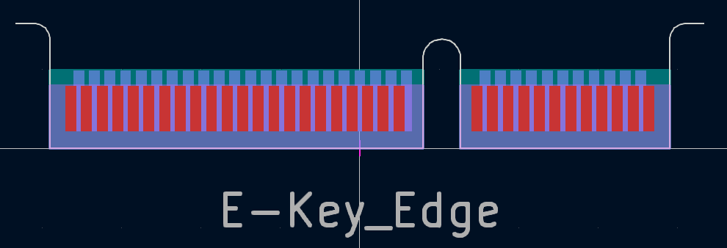
Used both scripting and layout editor in KiCAD for design
Edited from online templates
Designed custom footprint using scripting library found online
Notes:
Possibly repeated iterations of design; parameters must be compatible with mainboard & silicon die
Parametric design- not supported in KiCAD

Slide 6
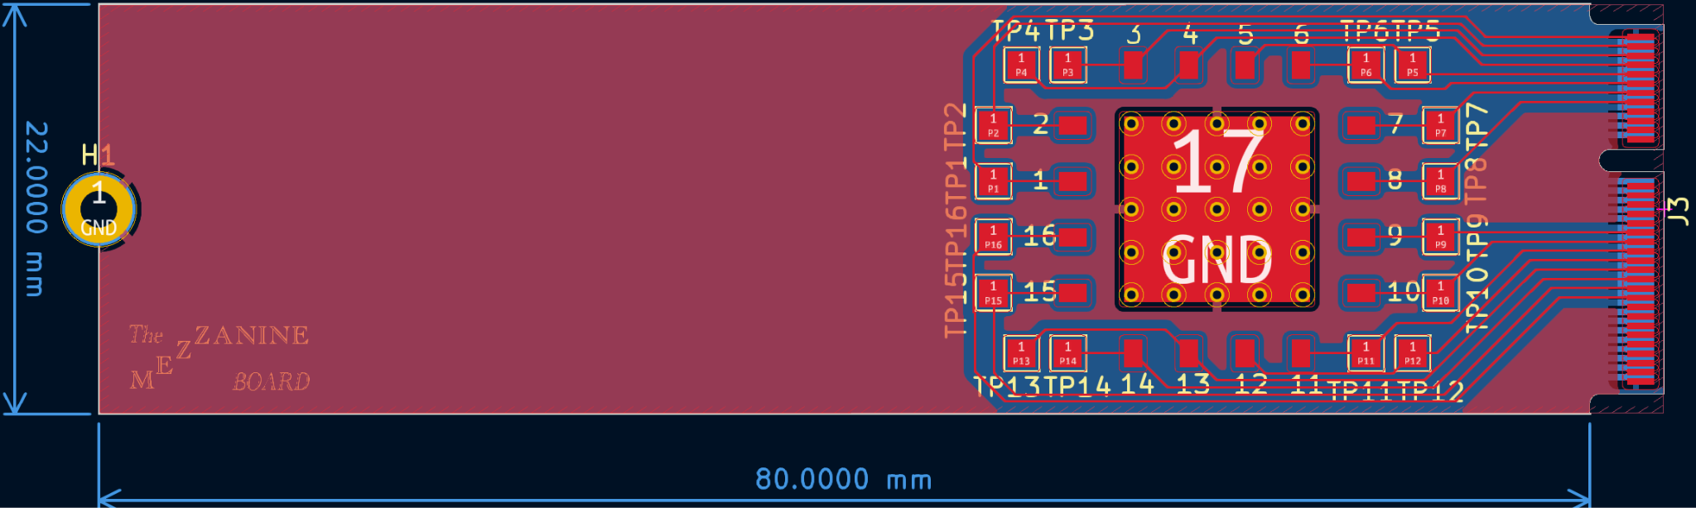
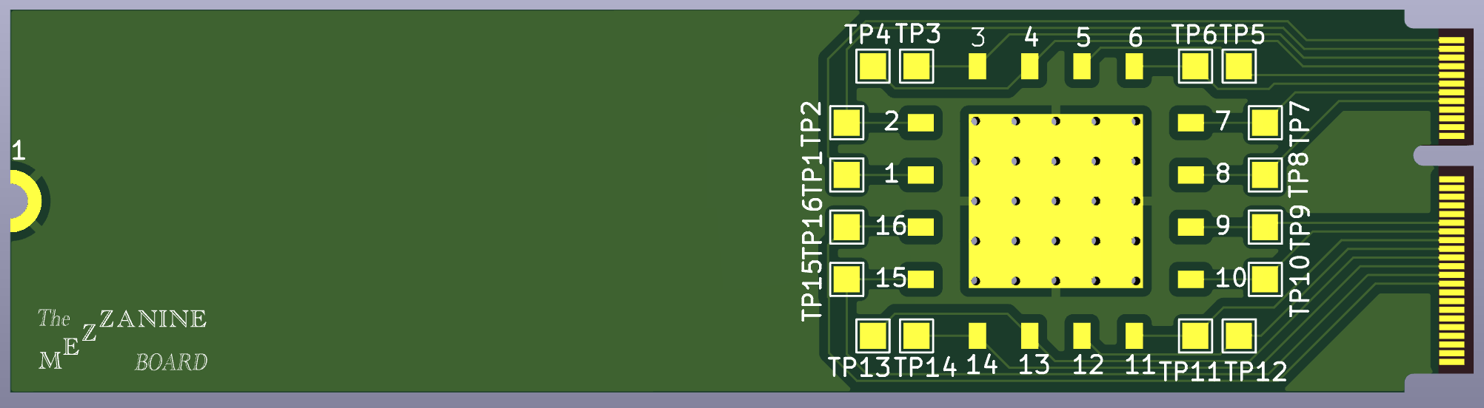
Final design

Slide 7
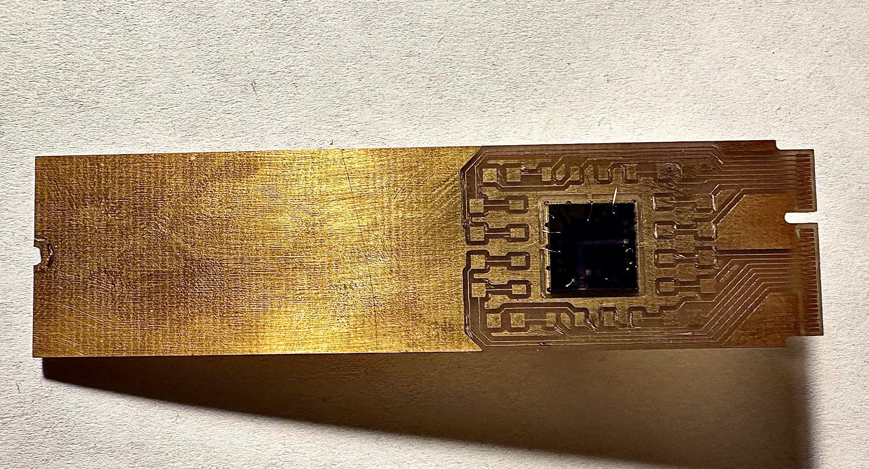
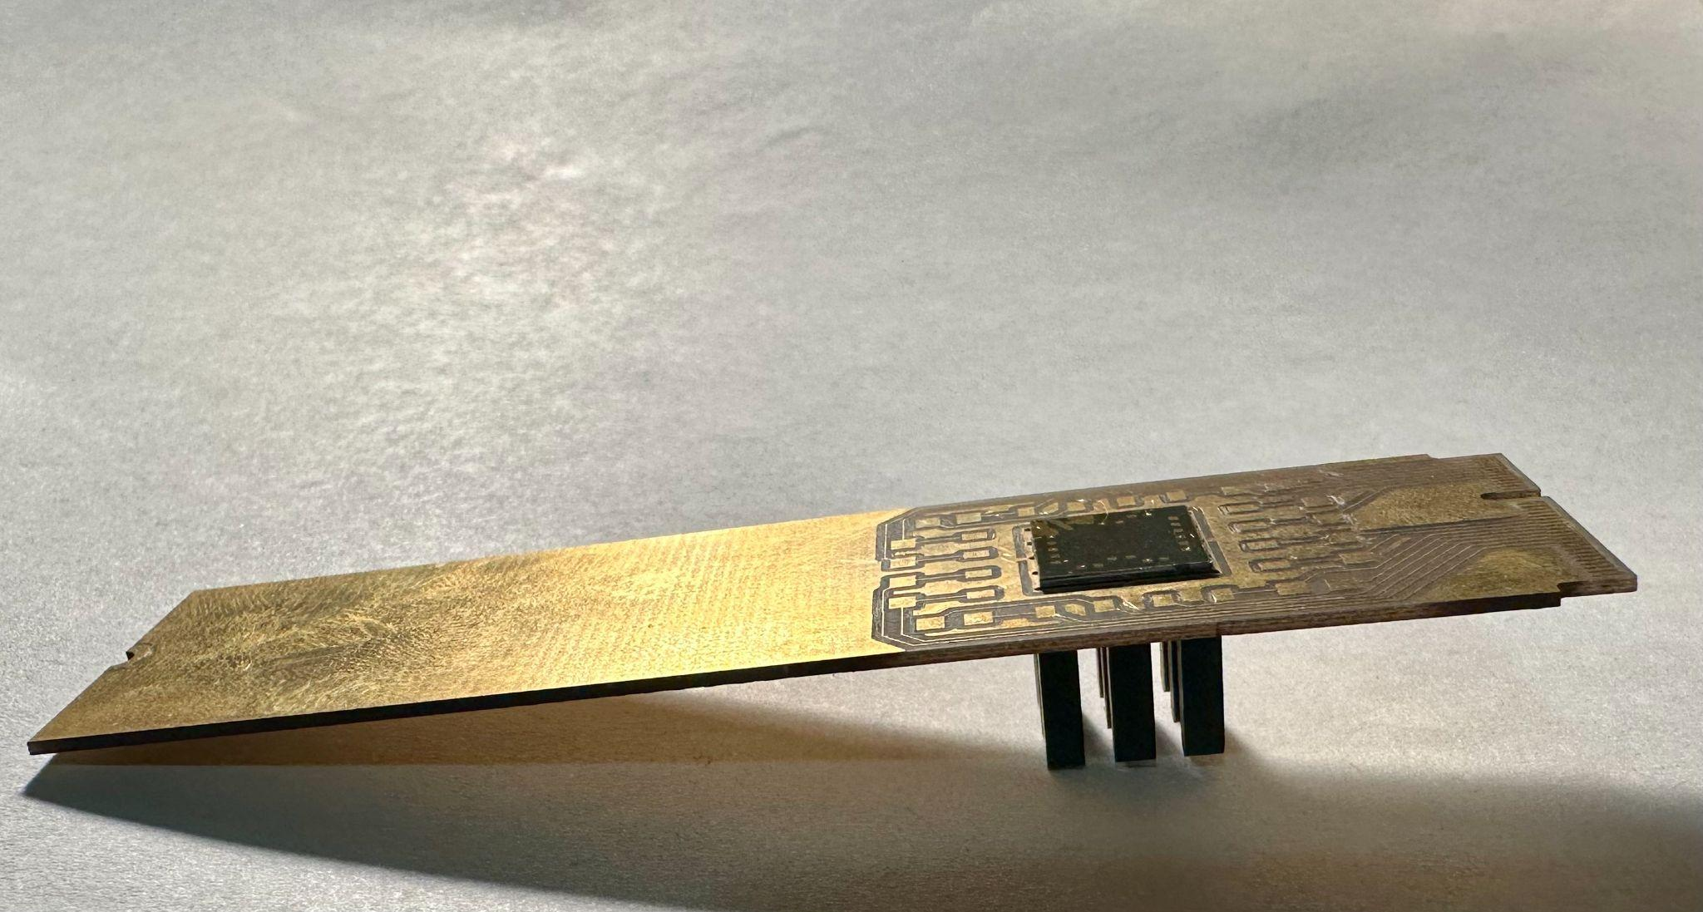
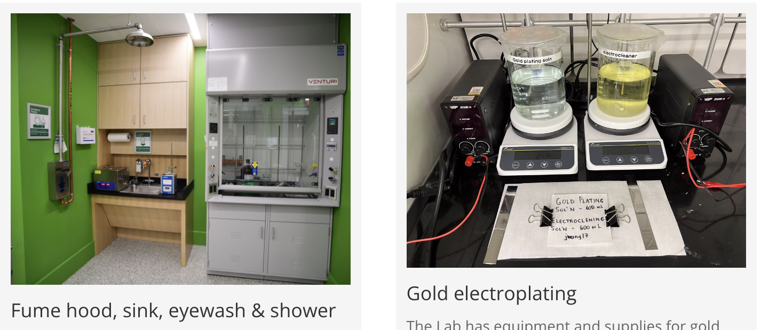
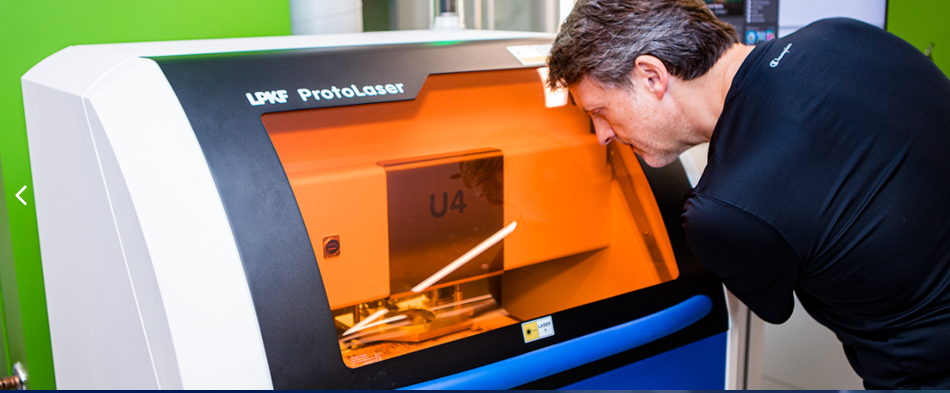
Made and tested a prototype in Rodger’s Lab
Images from Rodger’s Lab website
Notes:
Making a board with the laser cutting tool in Rodger’s Lab, test connections, adjust routing and vias sizes
Gold- plated the actual prototype with 0.8mm board
Unfortunately does not bond well to sample

Slide 8
Fabricated output

Slide 9

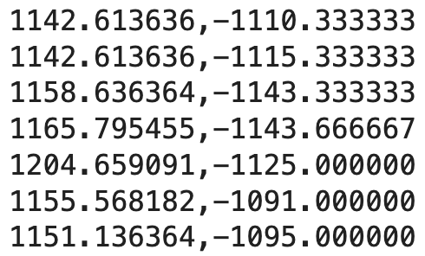
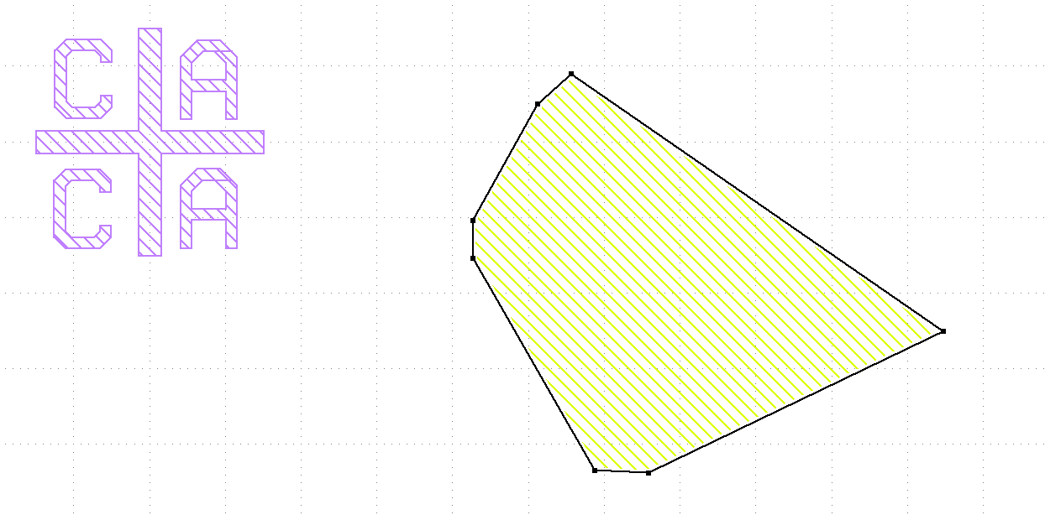
The silicon die design process have been tedious
Need for repeatedly designing the silicon die for different samples.
Morgan’s current program outputs coordinates of the nanostructure’s corners.
Silicon die design goal
Code output
Copy- paste into KLayout
Notes:
Reminder: silicon die again
Motivation: tedious to make designs
E.g. matlab process, screen-record video

Slide 10
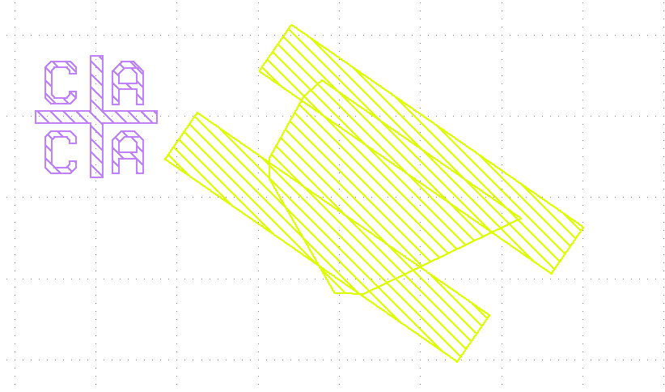
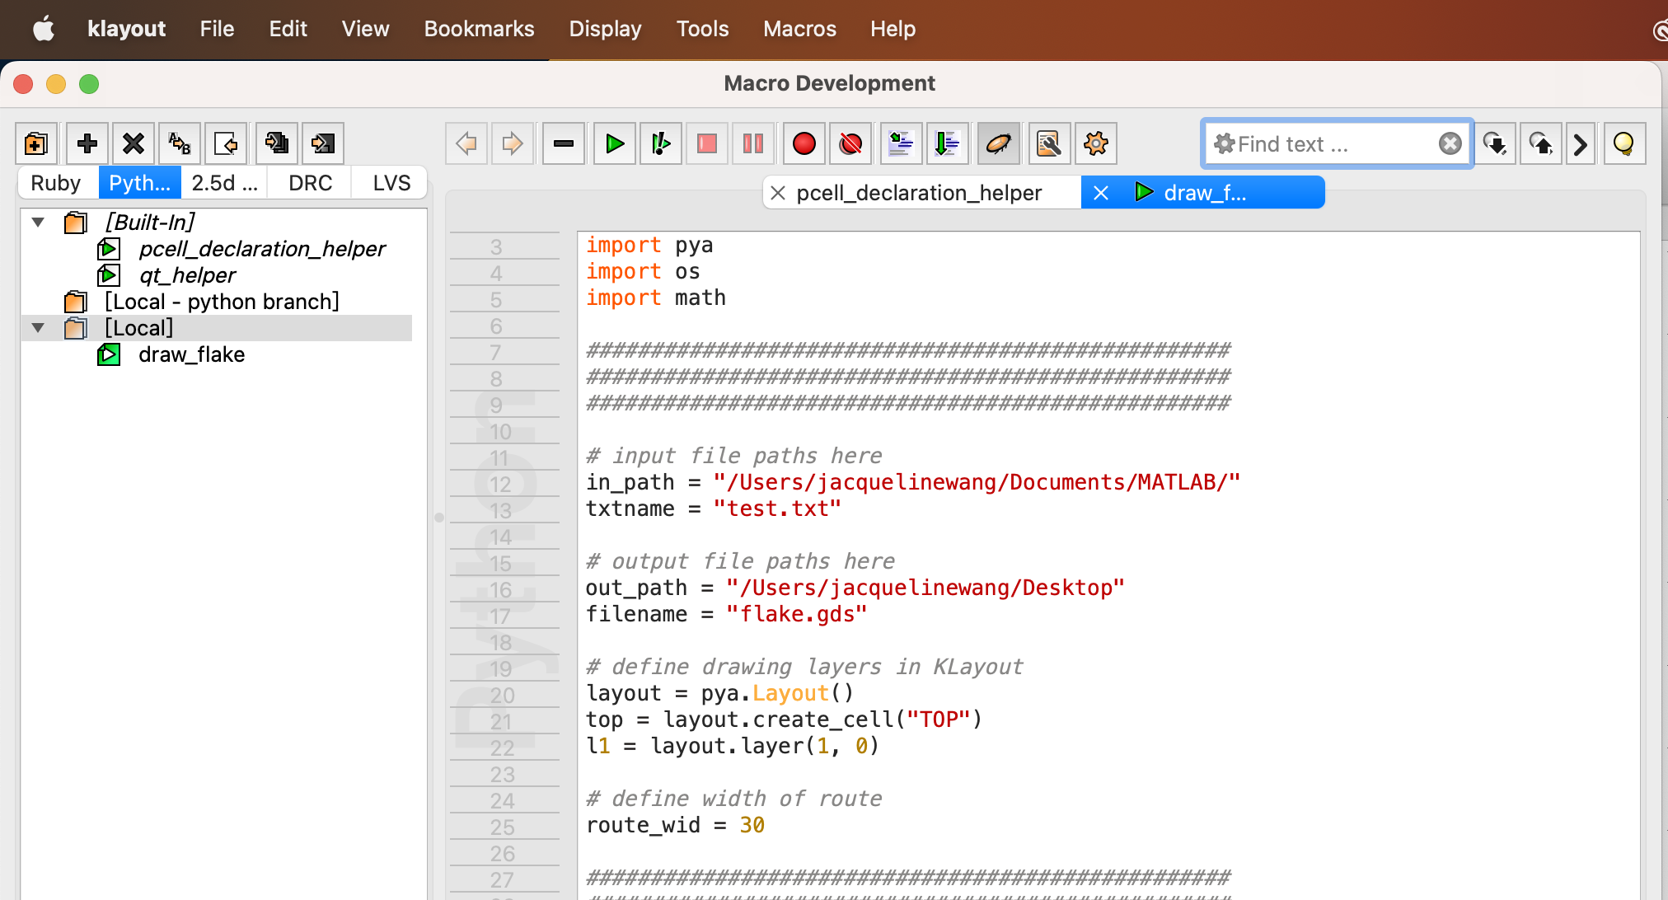
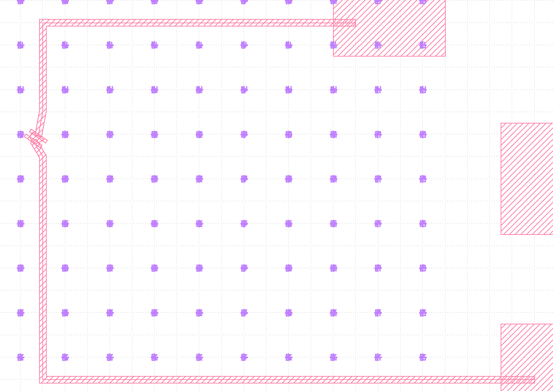
Automated electrode design for the silicon die
2. Directly read MatLab output file and write into KLayout
Design electrodes
3. Auto-routing that handles simple cases
Notes:
Electrode design:
More intuitive length and width definition
Allow more flexibility with electrode size and shape
Better user interaction
Routing:
More testing to clear potential bugs
Incorporate more design constraints, such as avoiding sharp turns, preferred angle with the electrodes, etc.
Simplify the decision process, potentially using very different idea and advanced algorithms.

Slide 11
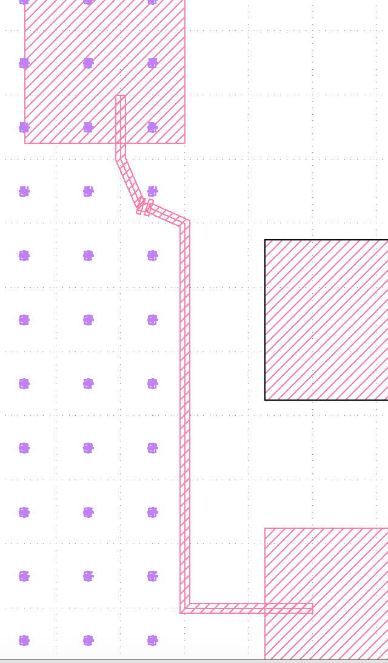
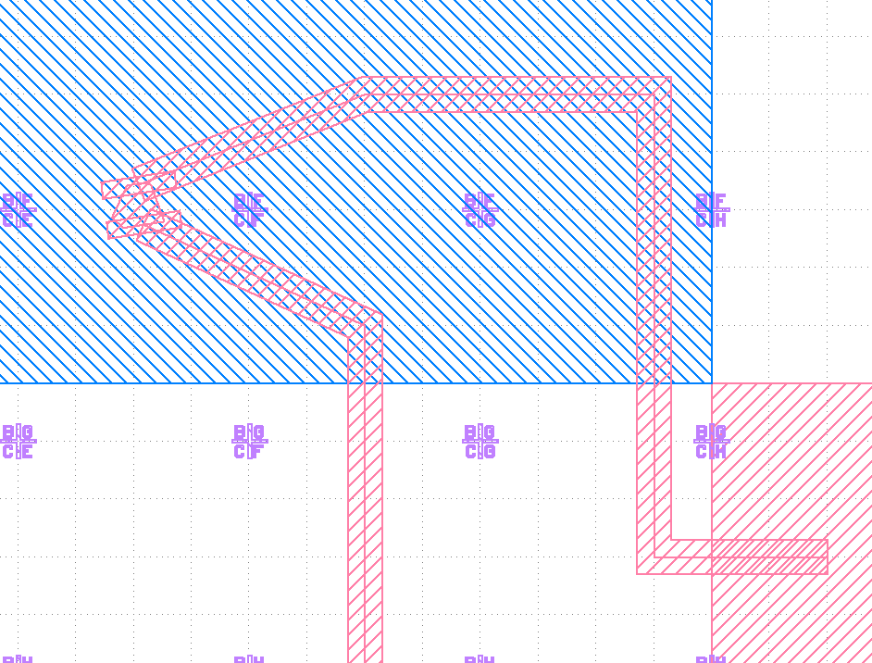
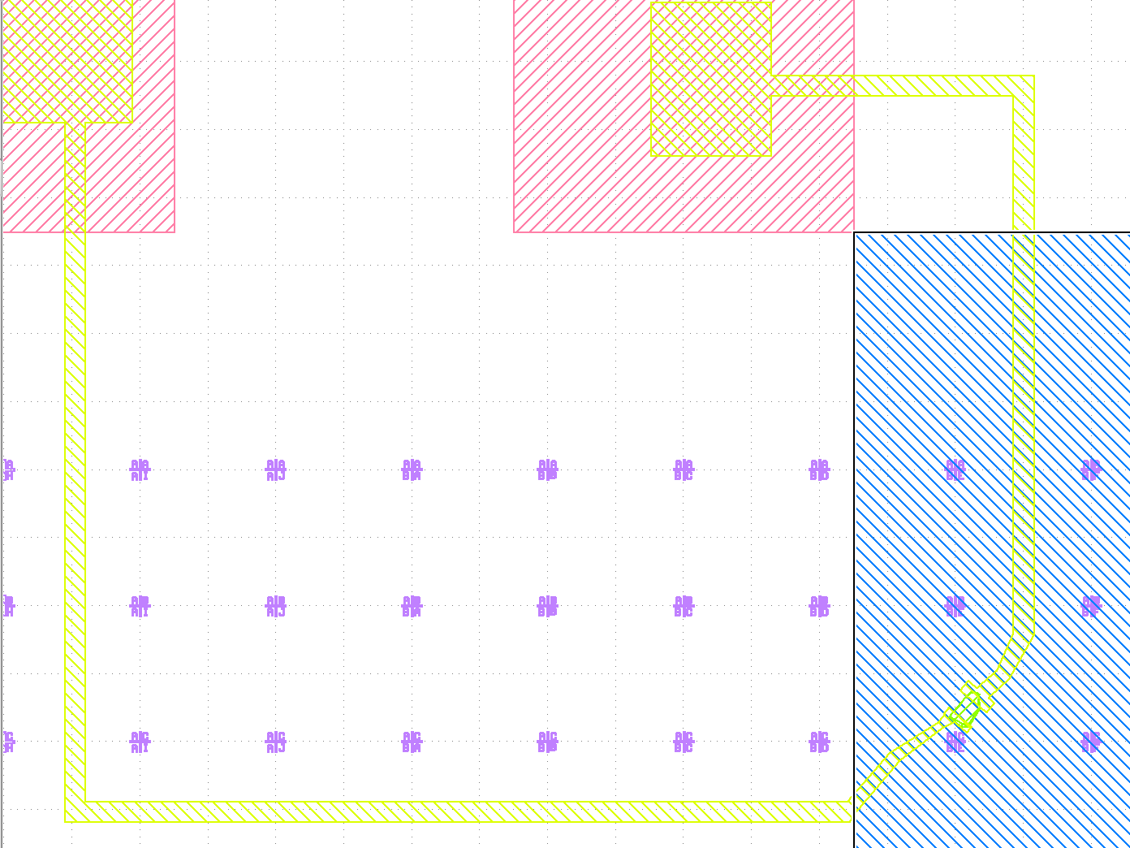
Examples of electrodes design
Designed by hand

Slide 12
Specific routing considerations
Intermediate routing points
Avoids markings
Avoid routes crossing
Choose a nearby pair of pads
Avoid sample
Notes:
Current capabilities:
Route to a “close enough” pair of pads in same number system as mezzanine board
Assign the pair of electrode to the pair of pads reasonably
Avoids the nanostructure, the markings, and the other route
Main idea:
route to “special locations” in between markings
Allowing various “modes” of routing; the program makes decision based on coordinate information

Slide 13
Conclusion
Easier repeated experiments; easier to assemble; easier to change between different samples
compatible
Allows easier repeated design iterations
Secure connection via Brady’s main board
Notes:
While the process is not yet fully automated and the design is not optimal, it is relatively easy and can allow multiple iterations of design within a short time, by changing a few parameters and re-running the program. It also has potential to be further developed to support more optimal design.
The mezzanine board requires more testing and potential adjustments along with the main board.
Ultimately, both projects are building towards to goal of allowing efficient measurements on different nanostructures. The code can make it easier to design silicon dies for different samples, which will be compatible with the mezzanine board design. The mezzanine and main boards can make it easy to repeatedly run experiments on fabricated silicon dies, easy to change different samples without re-working any connections with measurement device, and provide mechanically stable and electrically reliable connection between sample and measuring scope.
Urop experience:
Tried out many new things! Gold plating in Rodgers lab, various methods to fill vias (although did not need them in the end). Fun hands-on experience
More understanding of the PCB structure, how things actually work on the physical level
Applying skills to solve problem in an open setting- different from the very well-designed labs in class; how to approach problem, does not have a “solution” and knowing that ideas are not optimal, keep working on them and improving them as new unexpected things come up in testing
Most importantly: not knowing how to approach anything at first, to feeling more confident about trying different things out
Also importantly: time management & self motivation; communications/presentation
Interest in doing more research in the future; still not sure what but very excited to see how EECS is applicable in so many things
Summer: going home! Spend time with family and friends, good food, learn to drive, traveling?

Slide 14
Urop experience & summer plans
Urop experience:
Tried out new things & hands-on experience
PCB structure, how things actually work on the physical level
Applying skills to solve problem in an open setting
feeling more confident about trying different things out
Summer:
going home & spend time with family and friends
good food
learn to drive?
traveling？
Notes:
Urop experience:
Tried out many new things! Gold plating in Rodgers lab, various methods to fill vias (although did not need them in the end). Fun hands-on experience
More understanding of the PCB structure, how things actually work on the physical level
Applying skills to solve problem in an open setting- different from the very well-designed labs in class; how to approach problem, does not have a “solution” and knowing that ideas are not optimal, keep working on them and improving them as new unexpected things come up in testing
Most importantly: not knowing how to approach anything at first, to feeling more confident about trying different things out
Also importantly: time management & self motivation; communications/presentation
Interest in doing more research in the future; still not sure what but very excited to see how EECS is applicable in so many things
Summer: going home! Spend time with family and friends, good food, learn to drive, traveling?

